Slide 1
CAR BLACK BOX
Project On :
Presented By :
Santosh Ramesh Sunagad

Slide 2
CONTENTS
Introduction
Need
Requirements
Methodology
Conclusion
References

Slide 3

Introduction
What is Car Black Box ?
A car black box, also known as an Event Data Recorder (EDR), is a device installed in a vehicle to monitor various driving events. These devices typically record data such as gear shifting, time (Real-Time Clock), speed, and in the event of an accident, crucial information like the gear engaged, timestamp, and vehicle speed at the time of the incident.
It is also called as event data recorder.

Slide 4
Need Of CAR BLACK BOX
Car Black Box mostly focuses on enhancing safety standards of driven vehicle by monitoring vehicle performance and driving behaviour.
Whatever records recorded by this box can be viewed by law enforcement agencies in case of any issue.
If there any issue, your insurance company can also check this box and if you done the insurance you will get the money.

Slide 5
Requirements
Hardware
1. Display: LCD (16x2)
2. Matrix keypad switches
3. Potentiometer
4. External EEPROM Memory
5. Microcontroller (PIC18F4580)
6. RTC (Real Time Clock)
Software
1. MPLAB X IDE v6.00
2. MPLAB XC8 C Compiler
3. Tera term

Slide 6
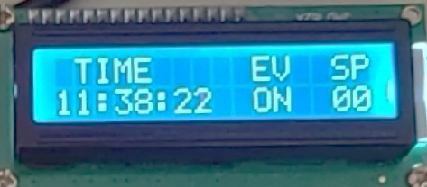
methodology
Here are the requirements of the project.
Default Screen :
When the system is in Operation Mode, it would act like a dashboard which would show the current time, speed of vehicle(depending upon gear position speed will vary) and the latest occurred event.
Gears – GR, GN, G1, G2, G3, G4, G5).
Collision key used for Collision event(C_).

Slide 7
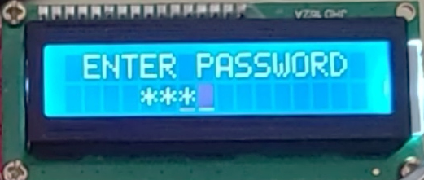
Login Screen
• On press of the UP or DOWN (User Keys) keys the system should prompt for password.
• The password would be the combination of 4 presses (User Keys).
• Each press should be denoted by a ‘*’ symbol.
• Every wrong entry would, re-prompt for password (Max 3 times for every 1 minute)
• Incomplete key press (pause of 5 seconds) would lead to Default Screen.

Slide 8
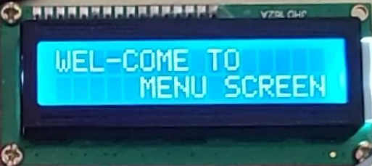
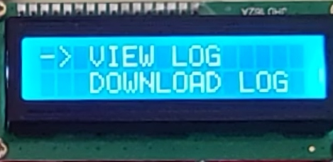
Main Menu
• The main menu should contain 5 option
• View Log
Clear Log
Download Log
Set Time
Change Password
• The UP/DOWN keys are used to navigate
A long press of UP Key should enter the selected menu
• A long press of DOWN Key should log out.

Slide 9
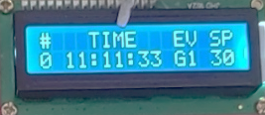
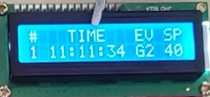
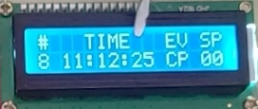
View Log :
• Should display all the events captured with log index starting from 0, like "EVENT NUMBER" "EVENT SIGNATURE" "EVENT TIME" "SPEED AT THE EVENT “.
• The UP and DOWN key will be used to scroll the entries.
• Rollover on reaching the max log entries.
• The system should be live (capture events occurred) even while changing PSW or clear the log .
• A long press of UP Key should take you back to main menu.

Slide 10
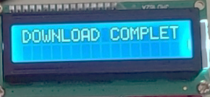
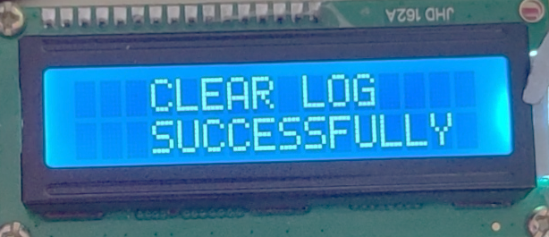
Download Log :
CLCD - Download log successful.
(Return to Dashboard screen)
UART – (Using Tera term Software Print all stored Logs).
CLEAR Log :
All logs should be Cleared.
CLCD - Clear log successful.

Slide 11
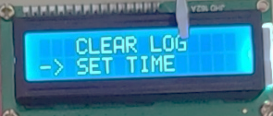
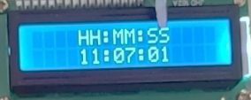
Set Time :
UP key - Field change
DOWN key - Increment field
A long press of UP Key should set time.
A long press of DOWN Key should logout.

Slide 12
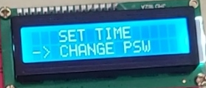
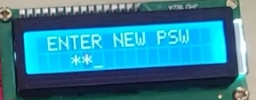
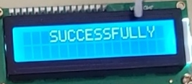
Change Password :
On press of the UP or DOWN (User Keys) keys the system should prompt for password.
The password would be the combination of 4 presses (User Keys).
Each press should be denoted a ‘*’ symbol.
Read password and read confirm password.
If both password matches then stored in External EEPROM.
A long press of DOWN Key should logout.

Slide 13
Conclusion
By implementing a Black Box which would log critical activities on the car and take appropriate actions in case of rash driving. The root cause of the negligence in the driving would be meeting the daily schedule and go off duty, or to earn extra money by illegal trips etc... So by implementing the mentioned solution it would be easy to keep track of how the vehicle is being used, handled and control the efficiency of the vehicle.
The proposed solution is to log all the critical events like the gear shifts with current speed and also Time, The system should allow a password based access to the transport managers to view or download the log to PC if required.

Slide 14
References
Event Data Recorder – Wikipedia.
Car Black Box - A sample technical specification.

Slide 15
Thank you

